Slide 1
At the tipping point: financial services in Africa comes of age An Accenture Point of View on the growth opportunities for Financial Institutions in Africa.

Slide 2

Contents
Executive Summary 3
The African Opportunity: 7 Why Africa? and why now?
The Tipping Point Index: 12 Which markets are most attractive for financial services growth?
Growth Triggers: 17 What drives financial services market growth in different African economies?
African Expansion: 24 How are global FS institutions entering the African market, and African institutions expanding across borders?
Business Models: 29 What business models are required for success in African environment?

Slide 3

Executive Summary

Slide 4
(1/3)
The economic growth potential for Africa is huge. Current changes in the underlying business conditions and increasing globalisation create strong tailwinds. While many African nations used to be held back by issues such as political and civil instability, poverty, poor infrastructure or governance – increasing numbers of countries are breaking these barriers.
Financial Services companies also have an important role to play in the African growth story, as providers of services and as participants in the development of financial infrastructure. These different growth factors create an attractive environment for Financial Services companies – either in markets where there is already established financial services market depth, or in countries where a ‘tipping point’ for financial services companies has been reached or soon will be.
This research paper examines:
The macro-environment for African growth and financial services development
Our ‘tipping point’ index to identify which countries are most likely to experience hyper-growth in financial services
Different growth trajectories in different countries and business lines
The current attraction of African markets to foreign participants and African banks
An outline of business models required to succeed in establishing an African presence
Accenture believes that the Continent ‘s current pace of change and potential future in the new “MultiPolar world” is still largely underestimated in most Financial Services analysis. Financial Services markets are either established or near
the “tipping point” of hyper growth in several countries. The players which will seize the emerging opportunities will build a sustained and lasting competitive advantage in these promising markets
Accenture has developed a proprietary “Tipping Point Index” (TPI) to identify the readiness of financial markets to take off, based on the combination of 29 different criteria grouped in three categories:
financial infrastructures such as financial markets sophistication, equity capital market etc.
existing depth of consumer markets such as banking penetration, insurance density etc.
economic development factors such as regulatory environment, market openness etc.

Slide 5
(2/3)
Based on the first release of the TPI analysis*, beyond South Africa and Mauritius, which have already established and somewhat mature FS markets, Accenture has identified:
five markets which are “forging ahead” to the tipping point of fast development
eight markets as “next movers”
additional markets which have hidden potential that can be unlocked quickly through some structural transformations
New triggers of FS sector growth exist and point to rapid market development in some countries. Although paths to growth are different in each country, frequent triggers include:
Innovation through (very) low cost offerings and distribution in order to radically transform the access to financial services for a large percentage of the consumers
FS Infrastructure development through more sophisticated FS regulations, and the development of IT, telephone, internet infrastructures and FS infrastructures
Investment in the economy thanks to FDI flows, trade flows and Financial Institutions following their clients into new countries
Rise of cities and urban consumers, emergence of new middle class, distributed consumers through low cost mobile in rural areas, rural/agricultural informal business through MFI
Replicating old business models will not be enough in Africa’s fast developing markets. New growth strategies are needed to have a lasting success across Africa.
Adapting traditional retail banking models to local cultural needs including traditional uses of money, family and kin relationships, and distributed populations, in addition to significant differences in
local business and regulatory environments pose a challenge to rolling out standardised models
Contributing to nation building and the development of local communities is a prerequisite in many countries across the region
Emerging strategies include:
Using one major local market as a base to expand market presence and roll out model across Africa
Following Corporate Clients across Africa
Deepen “localization” through acquisition of local “Giant” and integrate in Global network
For Retail banks, low cost Mobile Banking capabilities and alliances with telecom companies are a “must have” due the criticality of access, customer experience and scalability to take Banking to the Unbanked

Slide 6

The African Opportunity: Why Africa, and why now?

Slide 7
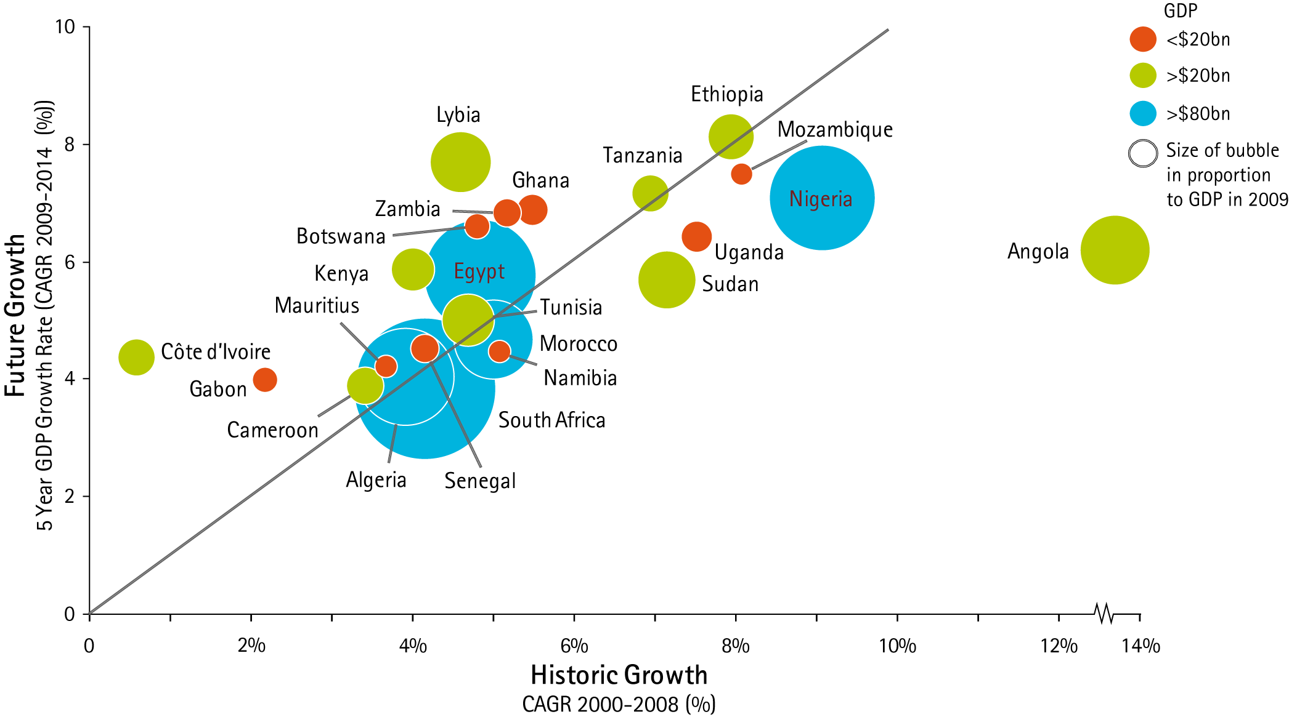
Forecasts predict high growth rates over the next 5 years – although growth paths are diverse
GDP Growth of Leading African Economies (CAGR)
Source: GDP current prices, World Date Bank, IMF, 2010

Slide 8
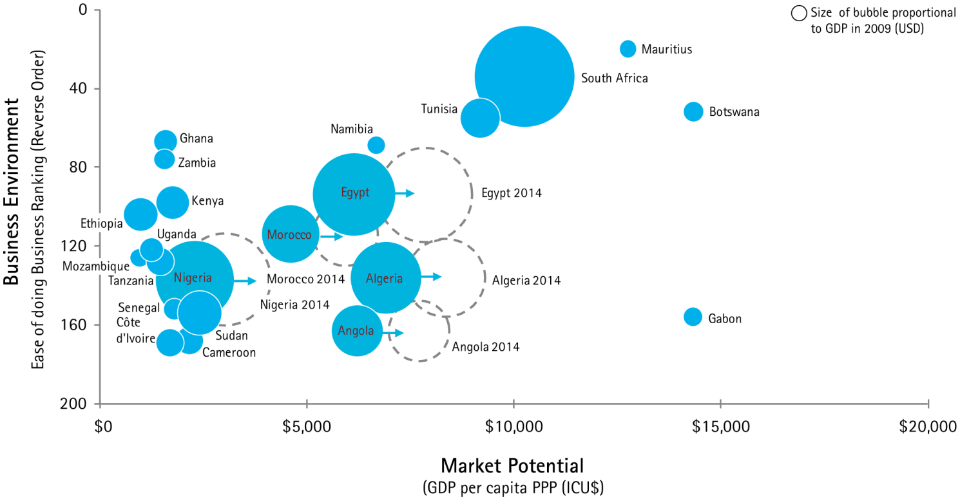
The Business environment has improved in recent years but is still very diverse; GDP growth will continue to push forward income and living standards in the largest economies
Leading African Economies: Business Environment and Market potential
The pace of reforms to improve the business environment has accelerated across Africa since 2007 and has not slowed down last year despite the economic uncertainty*.
The business environments are still very diverse across the region, and largely independent from the potential size of the markets
Economic growth will push more people into income categories where demand for financial services products increases
Source: IMF, 2010; World Bank, “Doing Business 2011” NB: no data for Libya.

Slide 9
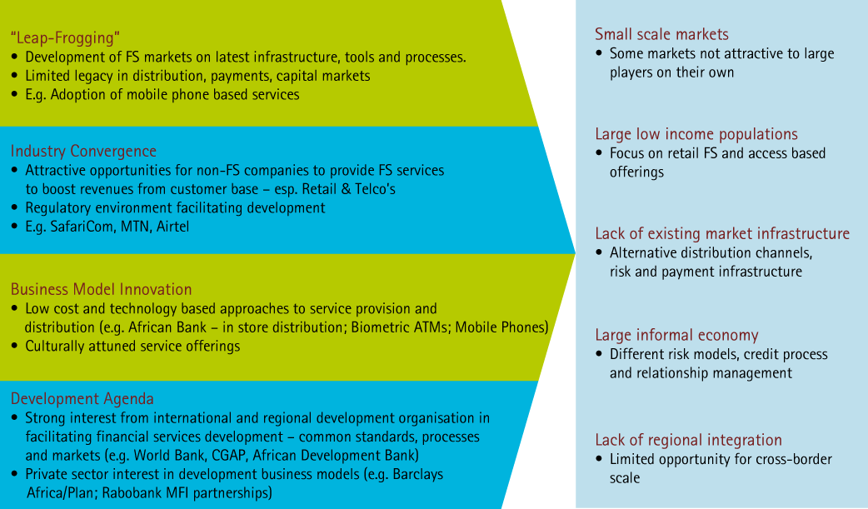
Trends suggest that the development of FS markets in Africa will not follow the same path as developed markets or other emerging markets
...While a set of factors may continue to restrict the shape of market development
Four forces are likely to drive a new form of financial market development in Africa...

Slide 10
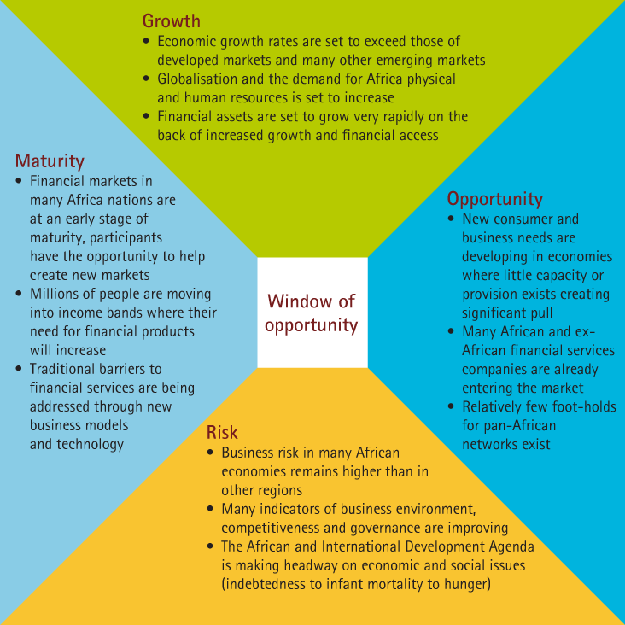
Why now? Growth opportunities for financial services companies are large, but the window of opportunity to seize them may be small

Slide 11

The Tipping Point Index: Which markets are most attractive for financial services growth?

Slide 12
The Accenture Tipping Point Index, understanding which markets are the most attractive for financial services growth
While the overall growth story for the African continent is positive, levels of development, financial depth and market scale and the business environment vary considerably between countries.
To develop a comparative lens for analysing different countries, Accenture has developed the ‘Tipping Point’ Index, which assesses a range of variables for 23 of the largest economies in Africa, across three main categories:
Financial infrastructure – such as the development and sophistication of financial markets
Consumer financial services – looking at the existing depth of and access to consumer financial markets
Economic development factors – such as economic growth, underlying institutions and regulatory environment
Our analysis shows a division between:
‘Established Financial Services Markets’ that are relatively deep and mature, with an existing diverse and thriving financial sector
‘Forging Ahead’ economies that tend to be larger, wealthier or more institutionally developed markets that are embarking on reforms that are creating more attractive financial services markets
‘Next Movers’ are a larger set of economies that have high potential and are in the process of overcoming barriers of low income, financial access, institutional or governance deficiencies
‘Transitional Economies’ where potential is constrained by barriers such as poverty, lack of financial inclusion, difficult business and civil environments and a lack of financial infrastructure
Note: While the availability of data on African economies is more limited than many developed markets, we have looked at leading international institutional data sources to obtain a ‘best available’ view.

Slide 13
Tipping Point Index - Financial Market Readiness The positioning of different economies will determine expansion strategies
Ranking is based on relative performance across 29 observations
Ranking is based on un-weighted performance against underlying variables
FS development in SA and Mauritius is well ahead of other countries
Next movers and transitional economies are in some cases impacted by the lack of existing markets e.g. no equity capital market – or lack of data availability
Some of the transitional or unrated economies may have hidden potential (e.g. Angola, Mozambique, Zimbabwe) that could be released through institutional change or structural reforms
Rank | Country | TPI Score
1 | South Africa | 0.73
2 | Mauritius | 0.54
3 | Egypt | 0.49
4 | Tunisia | 0.48
5 | Morocco | 0.43
6 | Nigeria | 0.41
7 | Botswana | 0.39
8 | Ghana | 0.33
9 | Namibia | 0.31
10= | Algeria | 0.28
10= | Libya | 0.28
10= | Zambia | 0.28
13= | Senegal | 0.27
13= | Kenya | 0.27
15 | Uganda | 0.25
16 | Gabon | 0.23
17= | Angola | 0.21
17= | Tanzania | 0.21
19 | Mozambique | 0.20
20 | Cote d’Ivoire | 0.19
21 | Ethiopia | 0.18
22 | Cameroon | 0.17
23 | Sudan | 0.11
Established FS Markets
Forging Ahead
“Tipping Point”
Next Movers
Transitional
Economies

Slide 14
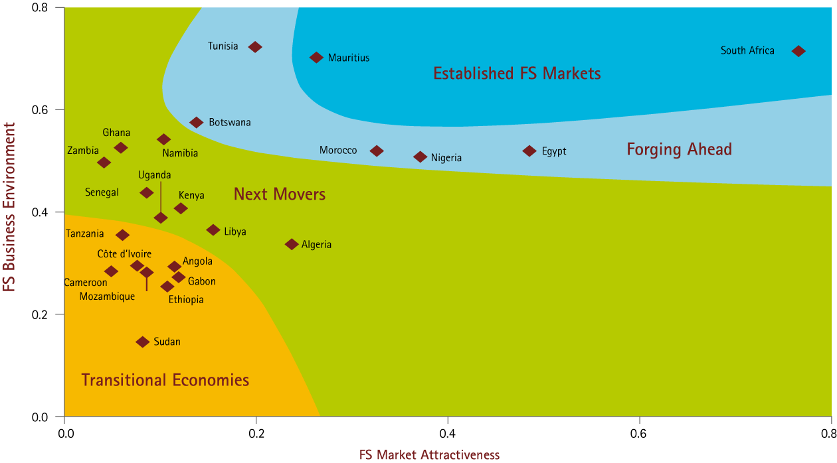
While a number of economies have a sound business environment for FS market development, relatively few also have the existing scale of population and depth of financial market assets to be immediately attractive
The TPI Dual Factor index examines the underlying variables related to the FS Business Environment and the FS Market Attractiveness to provide a deeper understanding of the market development and potential in leading African economies.
Tipping Point Index, 2009

Slide 15
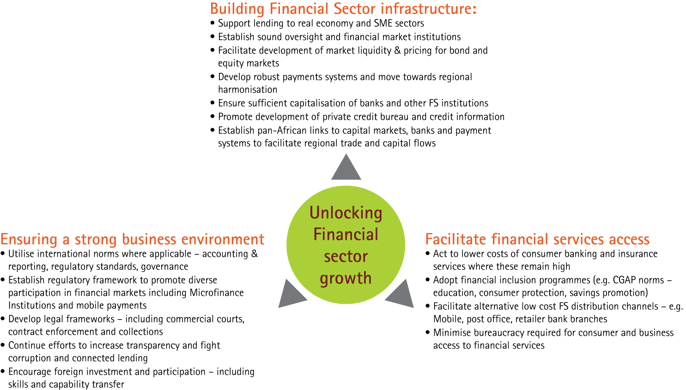
Countries that are forging ahead are implementing measures that are triggering the Tipping Point for hyper growth
Sources: Accenture Research analysis based on World Bank, CGAP, African Development Bank and WEF African Competitiveness Report

Slide 16

Growth Triggers: What drives financial services market growth in different African economies?

Slide 17
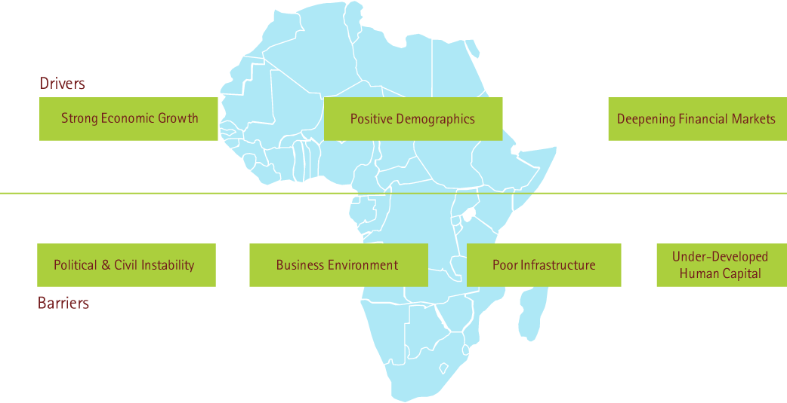
The financial market attractiveness of many countries in Africa is changing as strong growth momentum and many traditional barriers are tackled
A strong set of African economies present a set of attractive growth drivers (numerator) while tackling the fundamental barriers to growth (denominator) that have held back many countries from experiencing hyper-growth in financial services...

Slide 18

African Expansion: How are global FS institutions entering the African market, and African institutions expanding across borders?

Slide 19
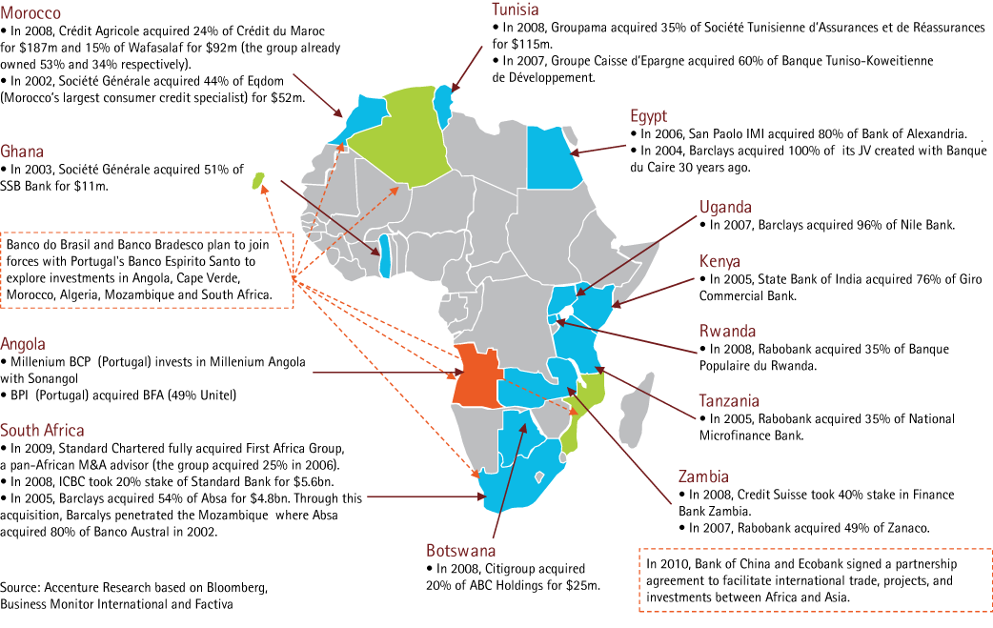
New entrants from Emerging Markets are challenging European Banks in Sub Sahara Africa

Slide 20
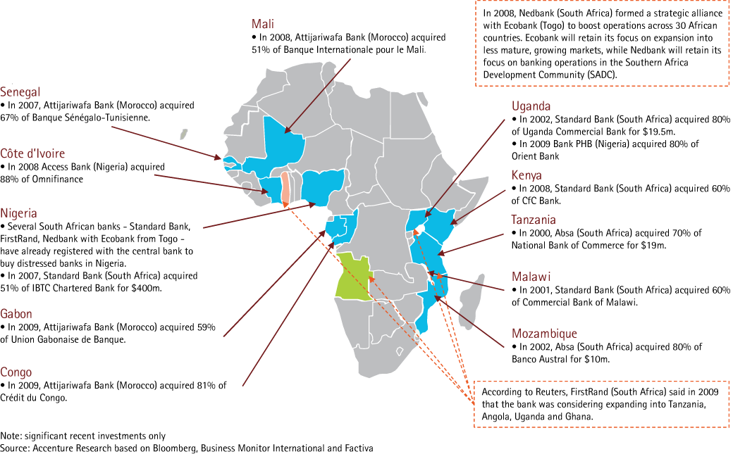
The current transformation of the Nigeria market may change the face of inter-African competition, largely based up to now on traditional regional and business areas of influence

Slide 21
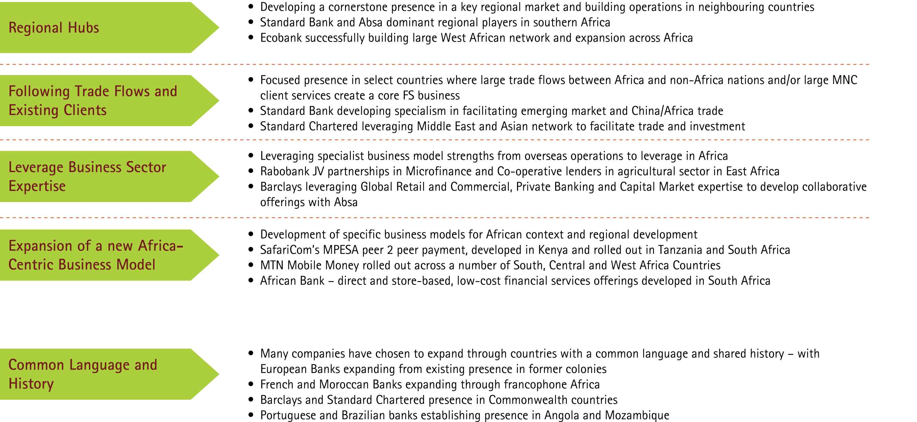
FS Companies expanding and acquiring in Africa are following a number of different approaches complimentary to their existing strengths and strategies
African FS Expansion Strategies
A key consideration

Slide 22
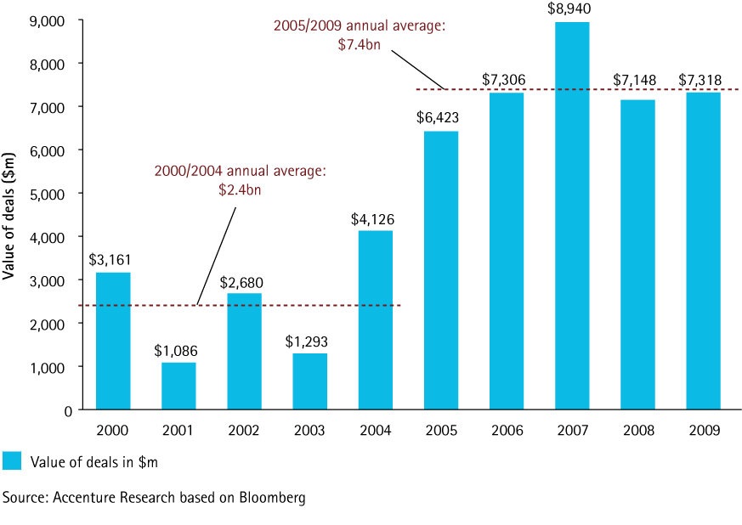
Gold rush: M&A in the African Financial Services industry have strongly increased since 2004
Financial Services Sector M&A Deal Value
Domestic and Cross-Border, $m
Sources: Accenture Research based on Bloomberg

Slide 23

Business Models: What business models are required for success in African environment?

Slide 24
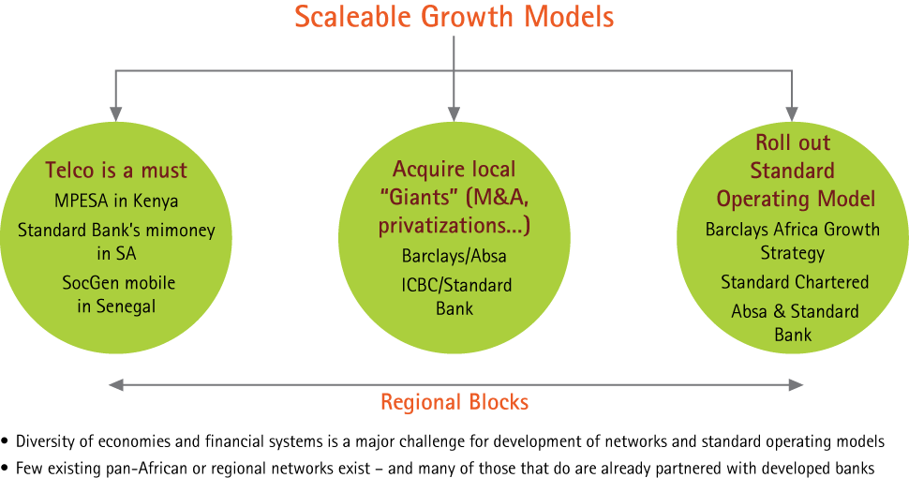
Innovative growth strategies are needed for Africa. Replicating old business models is not enough

Slide 25
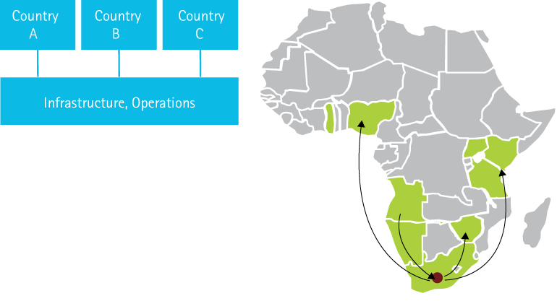
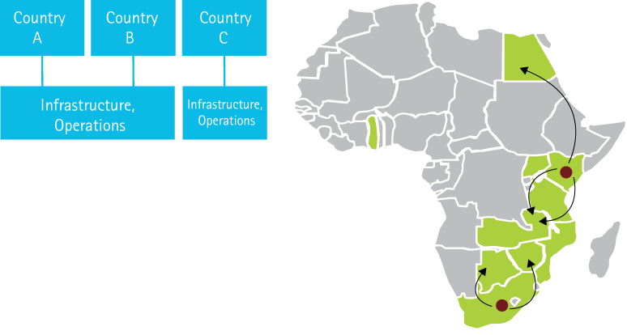
Four business models are likely to dominate African FS company networks – with a number of hybrids
1. Standardised Operating Model
2. Regional Operating Model
Operating model typology
Operating model typology
Multiple countries served by common systems, platforms and operations
Shared-services provide specialist support
Targeting high efficiency, consistent services and scale economics
Key challenge in supporting local market requirements – including different customer service requirements, payments infrastructure and regulation
More typical for Corporate and Commercial banking models
E.g. Ecobank, Standard Bank (Aspiration)
African regions served by common systems, platforms and operations
Some degree of shared-services provide specialist support
Targeting efficiency, consistent services and scale economics tailored to regions
Key challenge in supporting local market requirements – little regional harmonisation
More typical for retail business models
E.g. Absa/Barclays (Aspiration)

Slide 26
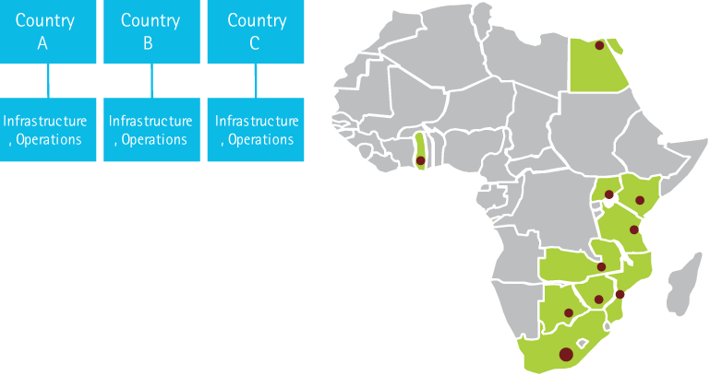
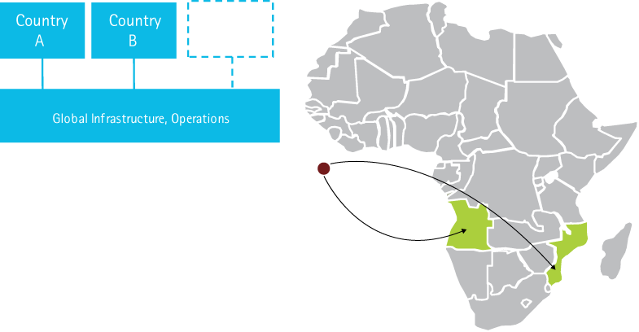
Four business models are likely to dominate African FS company networks – with a number of hybrids
3. Multi-Local Operating Model
4. International Supported Model
Operating model typology
Operating model typology
Each country supported by local operations, systems and infrastructure
Some shared-services provide specialist support in multi-country groups
Targeting responsiveness to local market needs
Struggle to develop efficiency or offered specialised services in small-scale markets
More typical for retail banking models, especially where local regulators require domestic operations and processing
E.g. Absa/Barclays (today)
Small local presence supported by offshore services, infrastructure and platforms
Majority of enterprise and specialist services provided offshore
Targeting customer acquisition and front office service, leveraging global servicing for efficiency or specialist services
Minimal local customisation
Typically focused on providing specialist services to local market, e.g. Trade, Corporate or Capital Market Services
E.g. Societe Generale (IT)

Slide 27
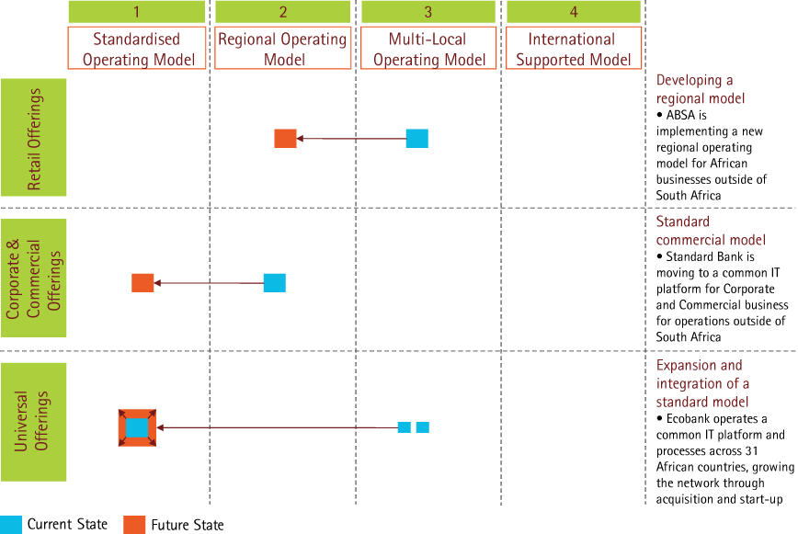
Pan-African banks are undertaking a rapid evolution of operating models to scale for growth, geared towards their target business lines

Slide 28
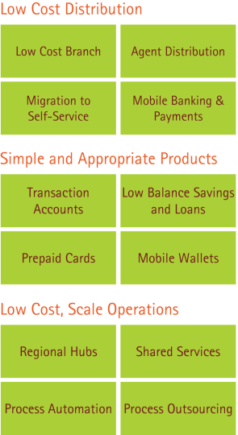
Retail banking in Africa has historically focused on smaller numbers of affluent customers. As the need for financial services grows new low cost distribution strategies will be required
While growing numbers of Africans are attaining income levels of a new middle class, traditional banking services remain too expensive for many.
The cost of extending banking access through traditional physical channels is prohibitive, and many low income customers provide thin margins for traditional banking models
Mobile payment solutions are providing a new low cost way to meet basic financial services needs, however these services are also low margin and for many operators are a way of increasing core revenue streams from selling air-time and reducing customer churn
For banks seeking to tap the potential of the emerging customer group, new retail models are required, including
Low cost distribution strategies
Simple, low cost products
Scale and low cost operations through regionalisation, shared services, automation and process outsourcing are required to reduce cost-to-serve

Slide 29
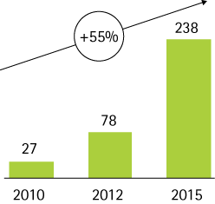
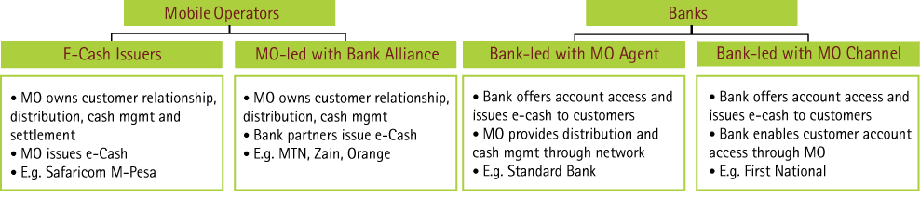
Mobile financial services are a growing force across Africa and an important part of the emerging FS ecosystem
Mobile FS is undergoing a rapid growth trajectory
African Mobile Subscribers (m)
27m Africans are expected to subscribe to mobile financial services at the end of 2010, this is forecast to grow to 78m by 2012 and 238m by 2015 as uptake increases and more providers roll out solutions in more countries
The total amount transacted is anticipated to grow to 7.5% of total African GDP in 2015 or $200bn earning mobile operators c$3bn revenue.¹
High mobile penetration, lower cost access to basic financial services and large alternative distribution networks are key drivers for customer uptake
Mobile Operators are playing a key role in driving growth –
as well as banks
The relationships between operators and banks are critical to business models
Regulatory issues for money supply, e-cash creation and cash management will shape the inter-relationship of Mobile Operators and Banks
As yet – Mobile Operators operating as banks, and 3rd party providers have not made significant impact on the African mobile FS market
Serving low income customers profitably is a major challenge – many mobile solutions are relatively low margin, but cross-subsidised by airtime sales; banks will be challenged to serve these customers without reducing margins for their overall business
Source: Pyramid Research, Mobile Financial Services in Africa, October 2010
¹ Pyramid Research, Mobile Financial Services in Africa, October 2010

Slide 30
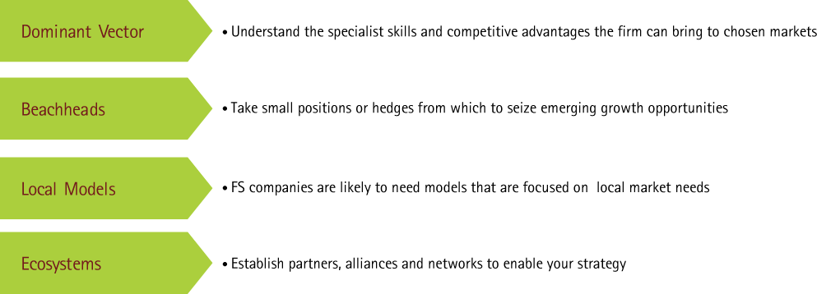
How does your organisation position itself to make the most of growth in African FS?
The diversity and complexity of financial services in Africa mean that there is unlikely to be a Pan-Africa Strategy
Instead organisations are taking a set of focused actions – including building a presence in select markets
Key Considerations

Slide 31
Financial Services in Africa offer the opportunity for banks and insurers to participate in a growth story that goes beyond profits
Growth potential in Africa is now real
Governments are proactively reducing barriers to FS growth building key market enablers
The Tipping Point Index shows that the African continent can not be treated as a single entity. There is differential attractiveness to foreign banks between African countries
But – a new group of fast movers that need to be taken seriously as a serious growth opportunity
Many countries are trying to skip a generation of evolution and create a FS environment highly customised to Africa
However, foreign banks can bring competitive advantages, know how and innovation
Considerable dexterity from foreign banks (c. 20) to “buy an option” on the Tipping Point
Business models – a large spectrum of entry strategies and scaling approaches to business
No single “best practice” but some early learning and some critical success factors are becoming visible
Establish an Africa Taskforce
Look for partners
Understand the relative attractiveness of different sectors
Define clear competitive advantages to bring to market

Slide 32
Appendix

Slide 33
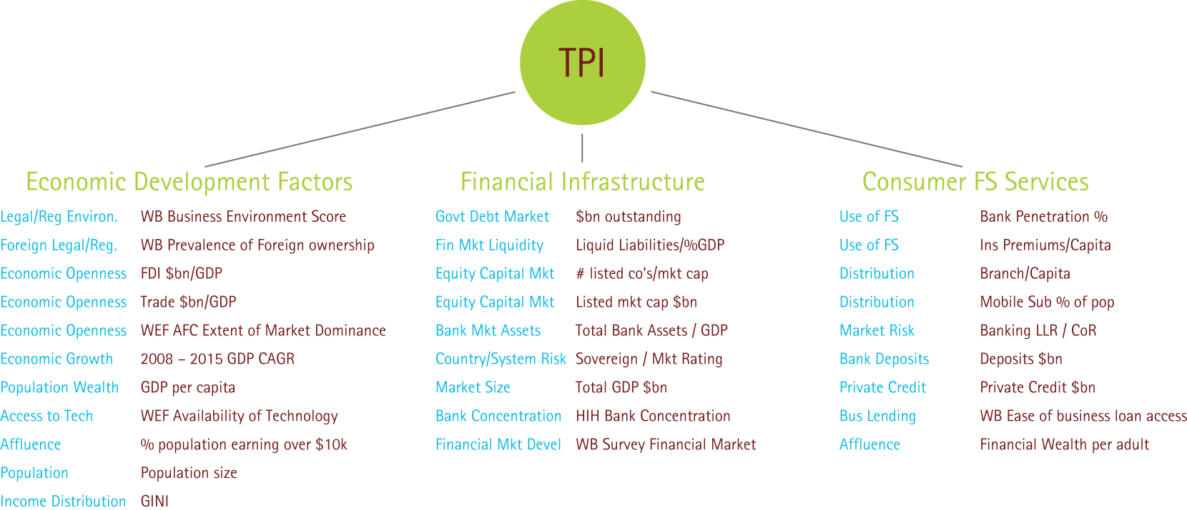
Understanding the attractiveness of different FS markets in Africa depends on an understanding of economic factors, financial infrastructure and existing depth of consumer FS markets
Tipping Point Index Methodology Financial Market Readiness
Are the conditions for growth present?
Readiness – which countries are in the take-off zone?
What do individual countries have to do to get to the take-off zone?

Slide 35
声明：
所有的版权属于原有公司，文件均来自公开渠道
此文件仅供学习使用，任何人不得进行以此为商业目的的行为
如有疑问，请立即删除
学习世界五百强和咨询公司PPT课程请访问如下网站搜索：“司马懿”
百度传课：司马懿PPT学校
网易学堂：司马懿PPT学校
知乎： 司马懿PPT学校
访问地址
https://www.chuanke.com
访问地址
https://study.163.com
访问地址
https://www.zhiu.com

